Slide 1
9.
Audit af software

Slide 2
Sikker software, hvorfor?
Usikker software
GDPR
Etik
Ansvarlighed
‘Prevention is cheaper than the cure’
NotPetya omkostninger på $1.2B
Phase | Relative cost to correct
Definition | $1
High-level Design | $2
Low-level Design | $5
Code | $10
Unit test | $15
Integration test | $22
System test | $50
Post-delivery | $100

Slide 3
Hvordan bliver software usikkert?
Design fejl
Privelegier
Insecure defaults
Defence in depth
Implementations fejl
Input validering
Fejlhåndtering
Maintainence
Unpatched software
Legacy systemer
Højkvalitetssoftware = Bedre sikkerhed

Slide 4
Patching
Er det altid korrekt at patche?
Spectre og Heartbleed
Feature patches
Patch modenhed og virksomhed modenhed
Sikkerhed versus funktionalitet

Slide 5
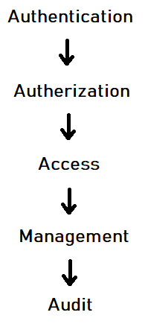
Access Control
Hovedelementerne af Access Control
Discretionary Access Control (DAC)
Adgang styres af administrator
Mandatory Access Control (MAC)
Adgang gives baseret på burger eller enheds niveau
Attribute-based Access Control (ABAC)
Adgang gives baseret på attributter
Role-based Access Control (RBAC)
Adgang gives baseret på roller
Rule-based Access Control
Adgang gives baseret på regler (tid og sted)

Slide 6
Gennemgang og testing
Test-Driven Development
Audit VS Black Box
Fuzzing VS Code Reading

Slide 7
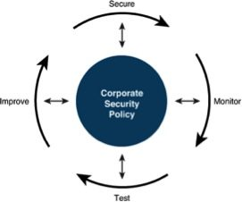
Security is a process - Bruce Schneier
… not a product
Processer og procedurer
Vulnerabilities
Dokumentation

Slide 8
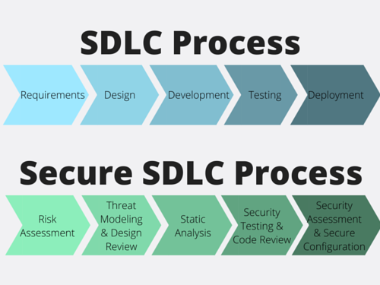
Secure Software Development Lifecycle

